Slide 1
May 2nd
Ainsley Lai

Slide 2
Overview
Previously Missing Eastern Caldera
Result of .json → .pkl change
Wasn’t accounted for in code (looked for instance_id+’.json’)
SPDF of ONE instance
MMSI → more ship info
AB, # research instances >> # other instances
OS, much fewer instances for specific ship types (non-Other <20 instances)
Transmission Loss Plot
SEL over range

Slide 3
Missing EC data

Slide 4
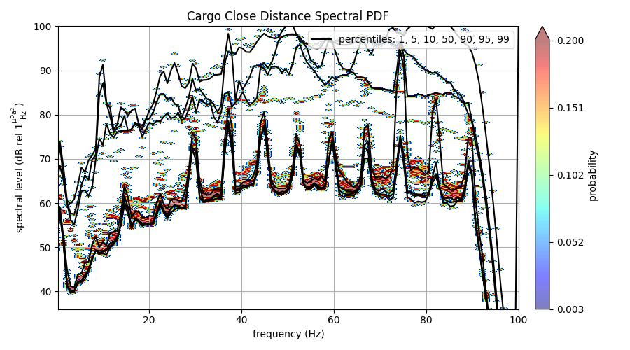
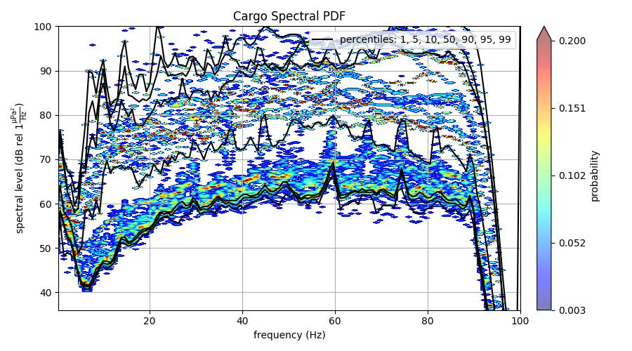

Slide 5
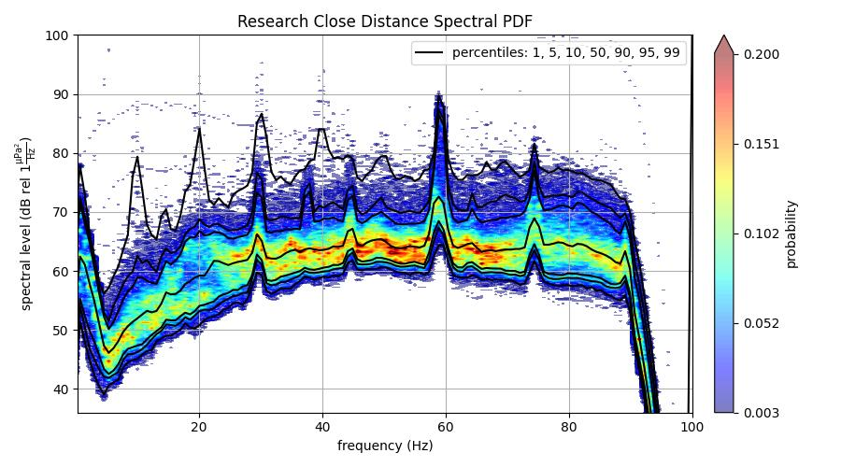
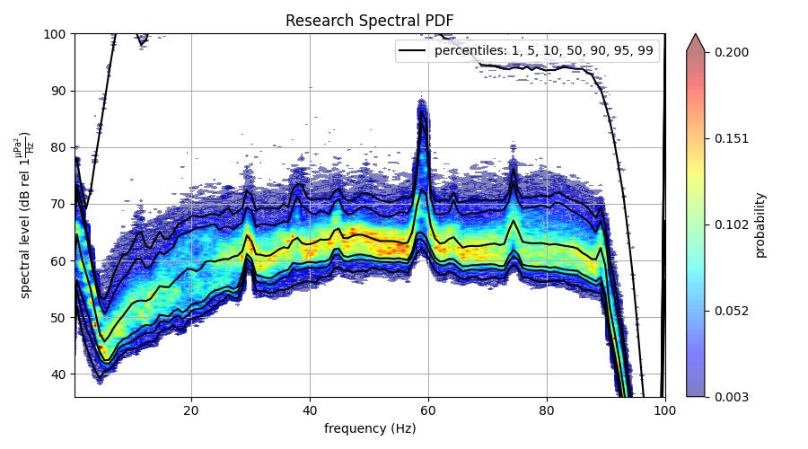

Slide 6
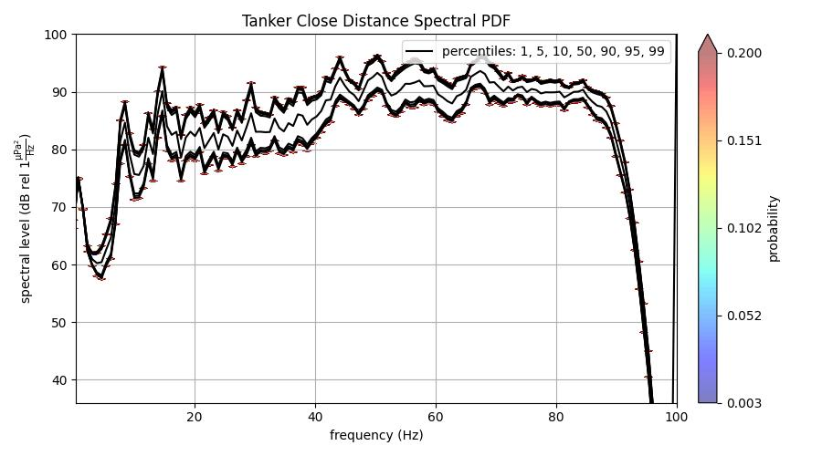
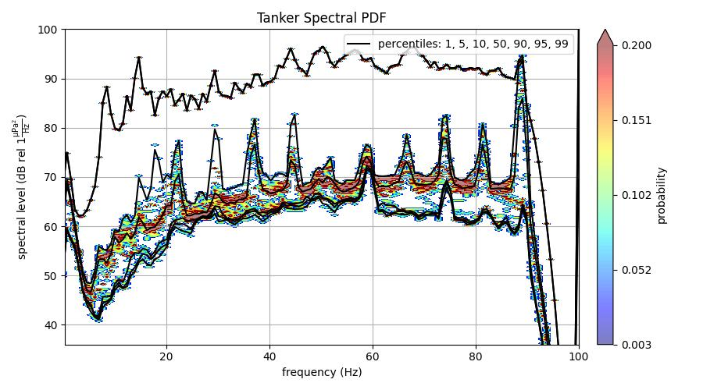

Slide 7
Single Instance SPDF and MMSI data

Slide 8
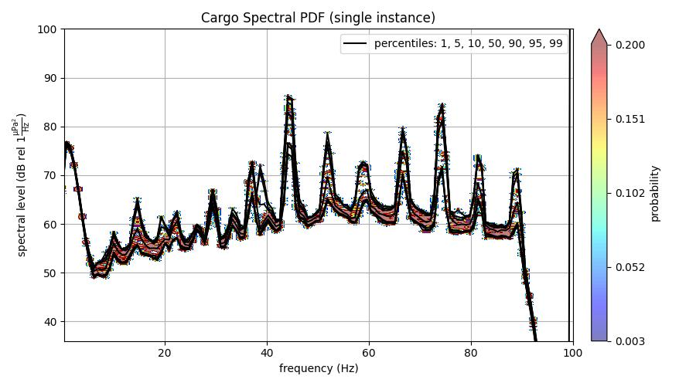
MMSI: 356190000
Bulk Cargo Carrier
Axial Base
https://www.myshiptracking.com/vessels/pantera-rosa-mmsi-356190000-imo-9402940
17 instances of data (much less than research vessels)

Slide 9
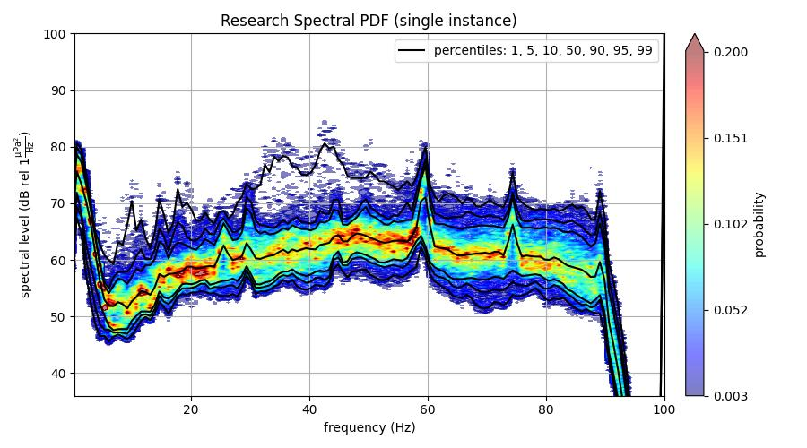
MMSI: 366345000
Research Vessel
Axial Base
https://www.marinetraffic.com/en/ais/details/ships/shipid:425257/mmsi:366345000/imo:8814419/vessel:THOMAS_G_THOMPSON
907 instances of data

Slide 10
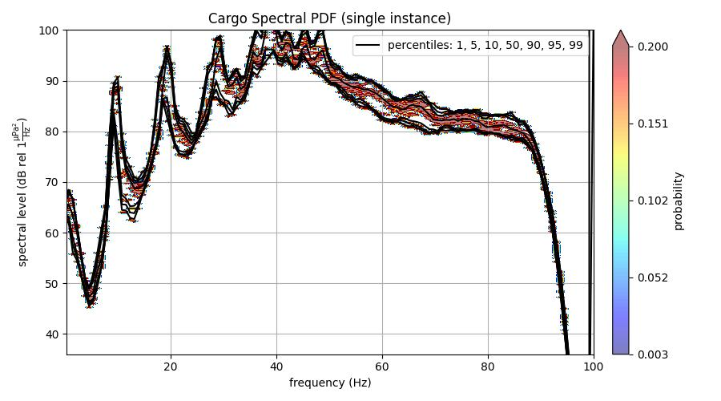
MMSI: 366364000
Cargo
Oregon Slope
https://www.marinetraffic.com/en/ais/details/ships/shipid:425308/mmsi:366364000/imo:7802718/vessel:KAUAI
13 instances of data

Slide 11
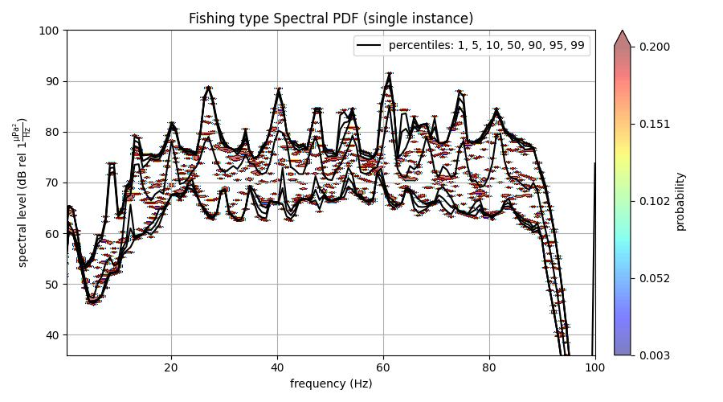
MMSI: 303668000
Fishing type (Towing)
Oregon Slope
https://www.marinetraffic.com/en/ais/details/ships/shipid:358900/mmsi:303668000/imo:9398474/vessel:GULF_RELIANCE
10 instances of data

Slide 12
Transmission Loss plot

Slide 13
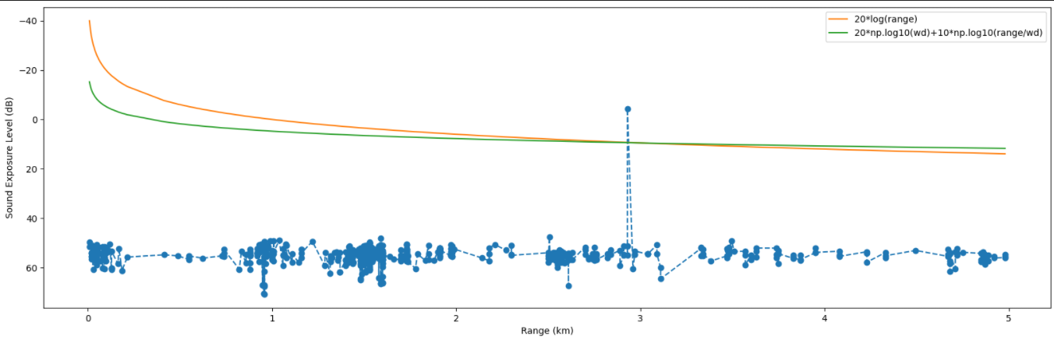
AB Research Vessel (above 366345000) Tx Loss Plot
Most instances among observed data
wd = 3 km (depth of hydrophone?)
Refer to code for implementation

